Slide 1
How Access The LMS For (Students)

Slide 2
Step 1:
On your browser and search KAG EAST UNIVERSITY and click on the first search result or type in the link https://east.university/

Slide 3
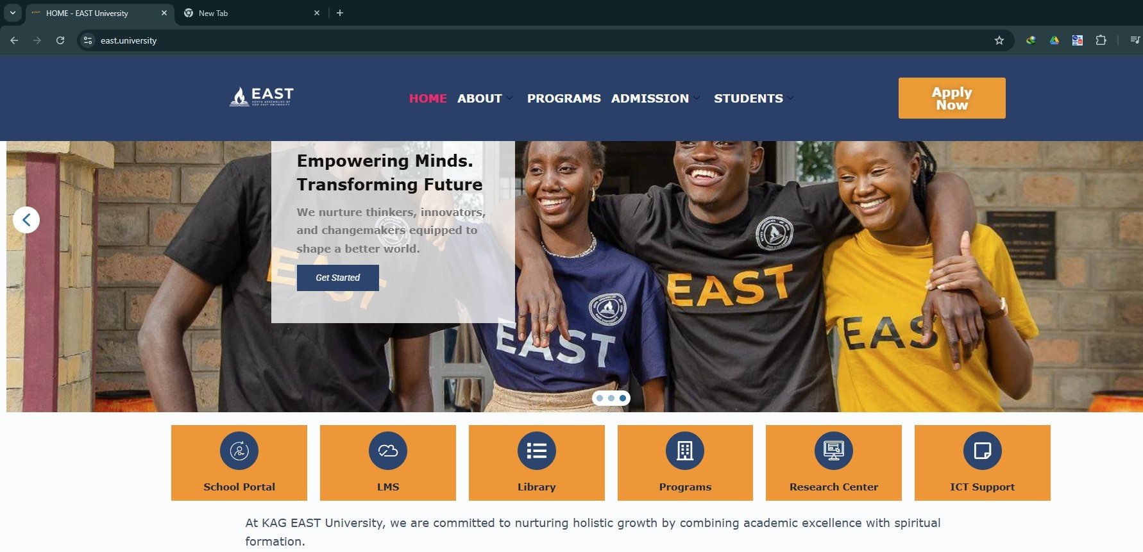
Step 2:
Navigate towards the Icon that says LMS and click on it

Slide 4
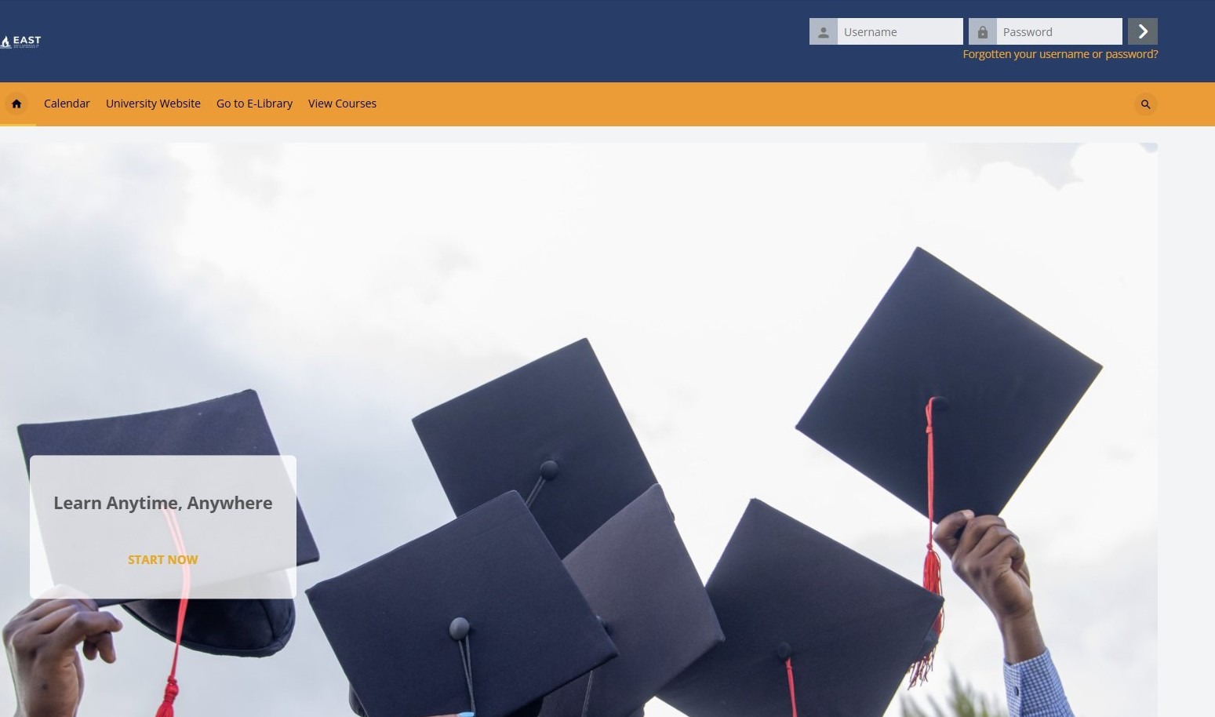
Step 3:
You will be required to login to the site via your username and password that will be provided for you by the IT department.
Username
Password

Slide 5
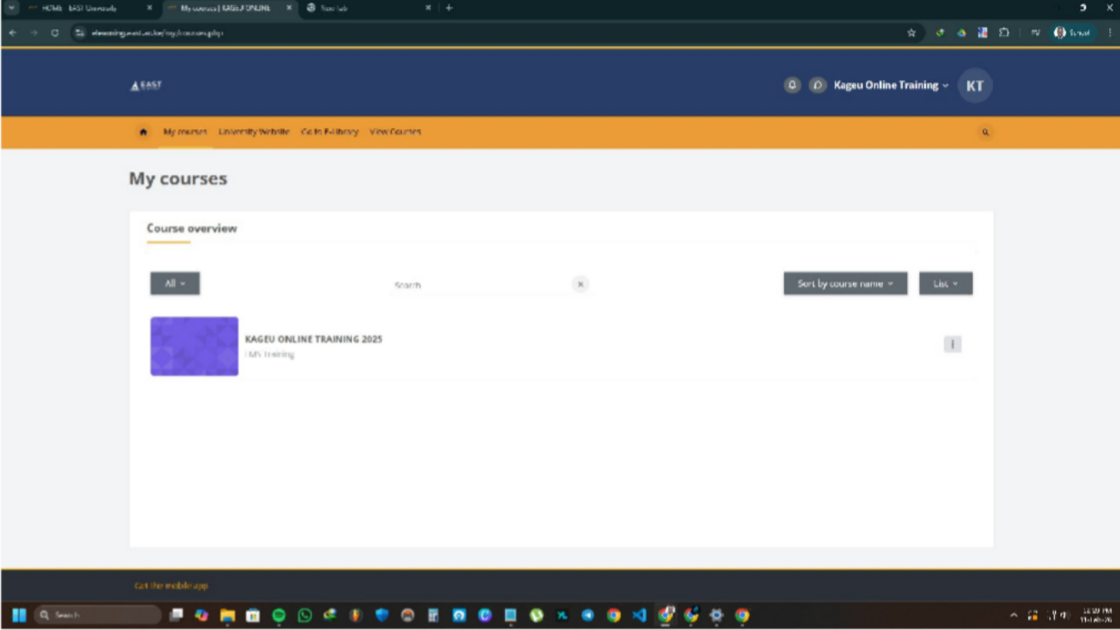
Step 4:
Once logged in proceed to click on my courses and access the units you have been enrolled for by the school admin.
Enrolled course

